Slide 1
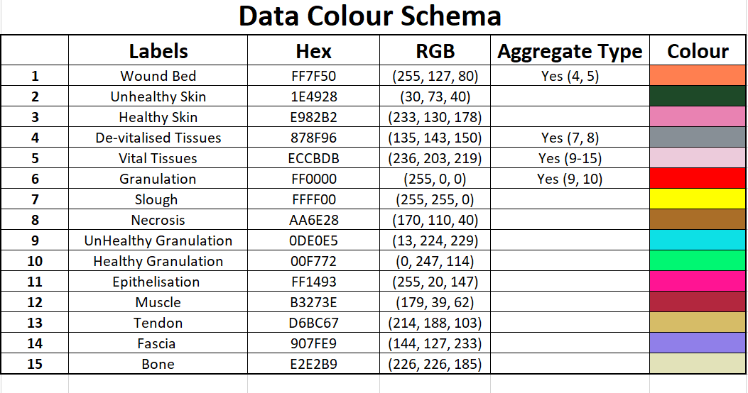

Slide 2
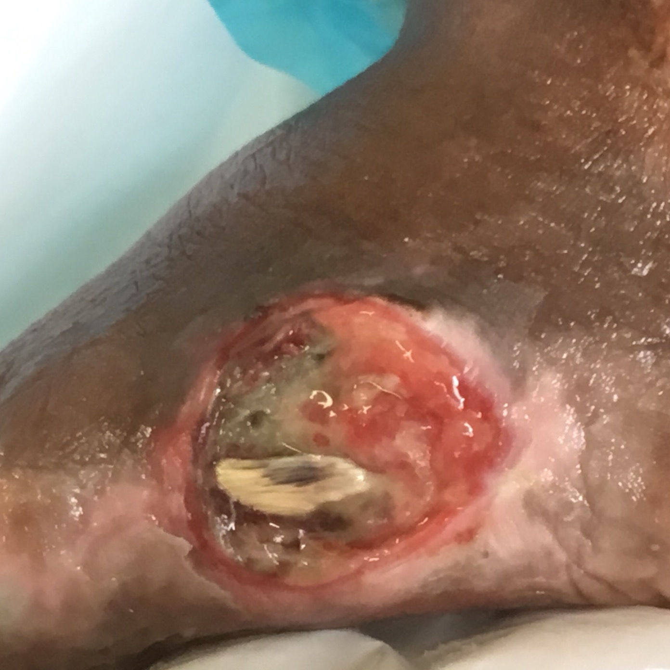
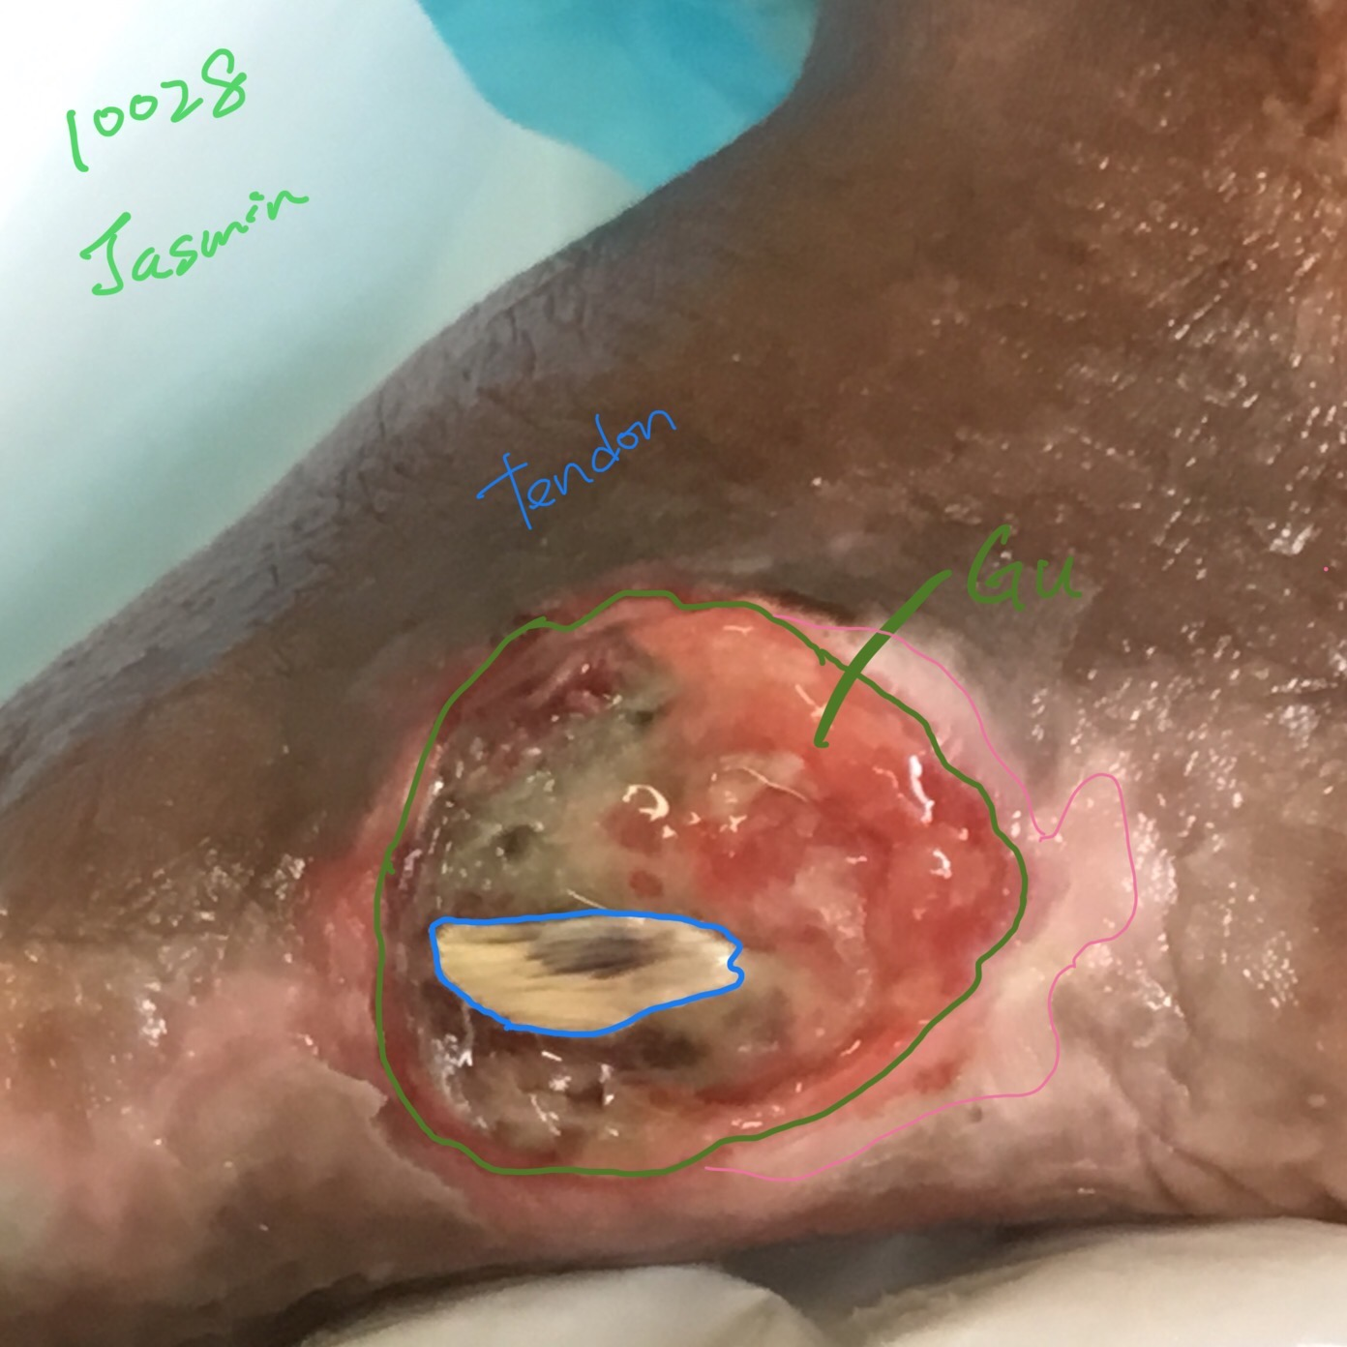

Original Wound Img
Latest Annotation
Original Mask
Metadata Wound Location: Foot Wound Type:

Slide 3
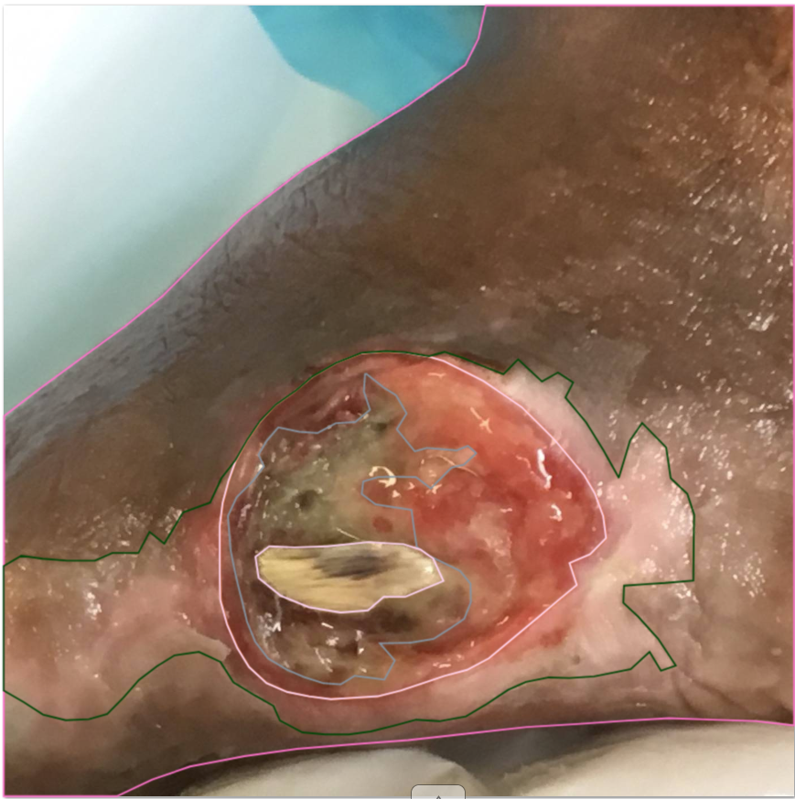
maceration/epithelizing?
black line margin is epithelization rest is unhealthy skin.
The blue line i would say is actually healthy skin.
Notes:
black line margin is epithelization rest is unhealthy skin.
The blue line i would say is actually healthy skin.

Slide 4

Original Wound Img
New Mask
Original Mask

Slide 5
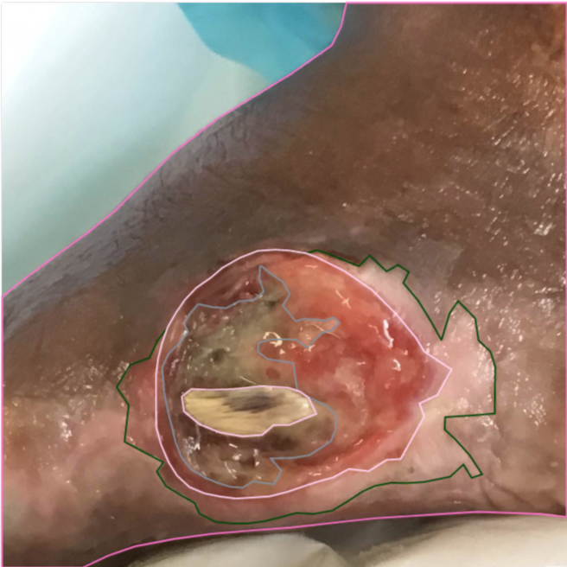

Slide 6
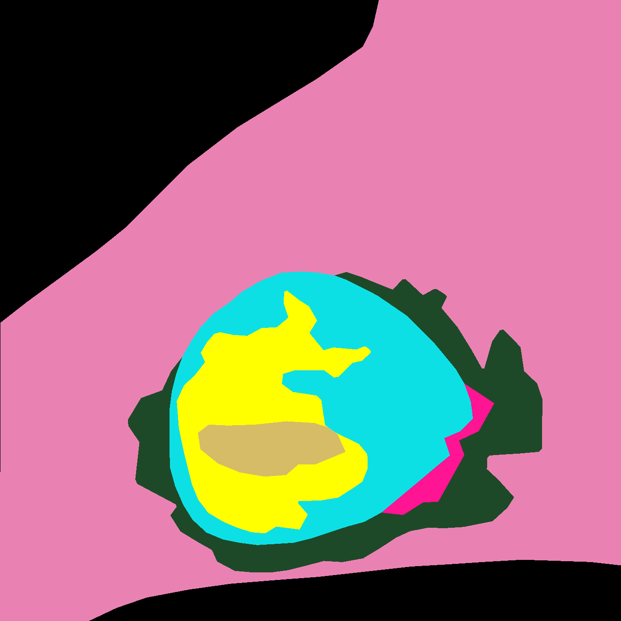
SD: Accepted

